Slide 1
Our Collocating Body Parts: Recurring Images of Self and Other in Body Part Usage
John Newman
University of Alberta
The Body in language: lexicon, metaphor, grammar and culture Conference
October 22, 2011
University of Warsaw

Slide 2
Overview
Methodologies
Sketch Engine
Collocates
Self vs. Other

Slide 3
Body Part research
Intrafield shifts/synonomy
‘hand’ ~ ‘arm’; ‘finger’ ~ ‘toe’
Interfield shifts/metaphor/grammaticalizations
Body parts <-> spatial relations
Body parts <-> numerals
Body parts <-> emotional/mental states
Koptjevskaja-Tamm, M. 2008. Approaching lexical typology. In M. Vanhove (ed.), From polysemy to semantic change: Towards a typology of lexical semantic associations. Amsterdam & Philadelphia: John Benjamins.
Methodologies Sketch Engine Collocates Self vs Other Conclusions

Slide 4
Variation in dictionary definitions
hand
the part of the human body attached to the end of the forearm, including the wrist, palm, fingers, and thumb [YourDictionary.com]
The terminal part of the arm beyond the wrist, consisting of the palm and five digits, forming the organ of prehension characteristic of man. [OED online]
Methodologies Sketch Engine Collocates Self vs Other Conclusions

Slide 5
Variation in dictionary definitions
hand
the part of the human body attached to the end of the forearm, including the wrist, palm, fingers, and thumb [YourDictionary.com]
The terminal part of the arm beyond the wrist, consisting of the palm and five digits, forming the organ of prehension characteristic of man. [OED online]
Methodologies Sketch Engine Collocates Self vs Other Conclusions

Slide 6
Wilkins (1996: 276)
Wilkins, D. 1996. Natural tendencies of semantic change and the search for cognates.
In M. Durie & M. Ross, The comparative method reviewed: Regularity and irregularity in language change. New York & Oxford: Oxford University Press.
Methodologies Sketch Engine Collocates Self vs Other Conclusions
Notes:
Dr =Dravidian, B = Bantu, AN = Austronesian, IE = Indo-European, TB = Tibeto-Burman
Proto-Indo-European *(o)nogh ‘nail, claw’ -> Engish nail, Slavic noga ‘foot’
Natural direction of change is for a term referring to a visible part to come to refer to the visible whole, not vice versa.

Slide 7
This presentation
Most research on body parts has tended to focus on (interesting!) change or variation in the meaning of a body part term.
In this presentation, I focus on the context of use of body part terms, specifically how body part terms co-occur with other body part terms in the British National Corpus
I am interested in the frequency of occurrence of interactional scenarios involving the body parts, as reflected in the British National Corpus
Methodologies Sketch Engine Collocates Self vs Other Conclusions

Slide 8
Sketch Engine
Sketch Engine is an online corpus tool, providing access to many corpora:
BNC (100 million words)
Chinese Internet (198 million words +)
…
Adam Kilgarriff, Pavel Rychly, Pavel Smrz, David Tugwell. The Sketch Engine. Proc. EURALEX 2004, Lorient, France, pp. 105-116. url: http://www.sketchengine.co.uk
Methodologies Sketch Engine Collocates Self vs Other Conclusions

Slide 9
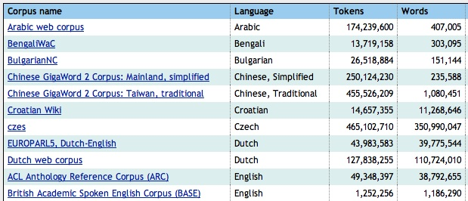
Some Corpora in Sketch Engine
Methodologies Sketch Engine Collocates Self vs Other Conclusions

Slide 10
Sketch Engine
Sketch Engine offers the option of a Word Sketch: “a corpus-based summary of a word's grammatical and collocational behaviour.”
This option takes us directly to familiar constructional types.
Adam Kilgarriff, Pavel Rychly, Pavel Smrz, David Tugwell. The Sketch Engine. Proc. EURALEX 2004, Lorient, France, pp. 105-116. url: http://www.sketchengine.co.uk
Methodologies Sketch Engine Collocates Self vs Other Conclusions

Slide 11
Sketch Engine: Word Sketch for HAND
Methodologies Sketch Engine Collocates Self vs Other Conclusions

Slide 12
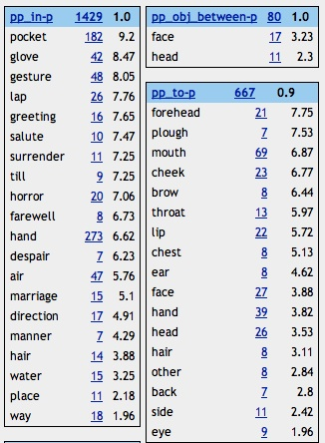
Word Sketch for HAND
head between her hands
put her hand to her head
hands in her hair
Methodologies Sketch Engine Collocates Self vs Other Conclusions

Slide 13
head [between…hand(s)]
Methodologies Sketch Engine Collocates Self vs Other Conclusions

Slide 14
Collocates
hand:
adj: other, right, left, free, upper…
noun: head, _shoulder, arm, man, finger…
verb: hold, put_, shake, raise_, reach ...
M. Davies & D. Gardner. 2010. Frequency Dictionary of Contemporary American English: Word Sketches, Collocates, and Thematic Lists. London and New York: Routledge.
Methodologies Sketch Engine Collocates Self vs Other Conclusions

Slide 15
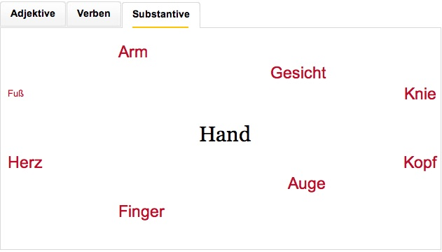
Das Duden Stilwörterbuch online
Das Duden Stilwörterbuch. http://www.duden.de/rechtschreibung/Hand#block_9
Methodologies Sketch Engine Collocates Self vs Other Conclusions

Slide 16
Collocates: levels of granularity
Collocates, disregarding construction type
HAND – HEAD could involve any of these examples:
I slid a hand beneath his head
She laid a hand on her head
Right hand behind your head, left hand on hip
I threw up my hands and inclined my head
She raised her head from her hands
Ricardo bends his head and puts a hand to a yawn
Carrying a severed head in one hand
Graham shook his head and waved one hand at Slater’s jeans
Methodologies Sketch Engine Collocates Self vs Other Conclusions

Slide 17
Collocates: levels of granularity
Collocates, by construction type (“collexemes”)
HAND – HEAD could involve any of these examples:
I slid a hand beneath his head
I slid my hands beneath his head
I slid my right hand beneath her trembling head
I slid my hand beneath my head
Methodologies Sketch Engine Collocates Self vs Other Conclusions

Slide 18
HAND constructions
 | SELF/OTHER
hand through hair | SELF | 87/90
hands on hip(s) | SELF | 84/86
hands over ears | SELF | 41/41
hands behind head(s) | SELF | 29/31
hands on knees | SELF | 26/26
hand on arm(s) | OTHER | 201/201
hand on knee | OTHER | 20/22
hand(s) in hair | OTHER | 14/14
hand(s) from shoulder(s) | OTHER | 11/11
Methodologies Sketch Engine Collocates Self vs Other Conclusions

Slide 19
HAND constructions
 | SELF/OTHER
hand through hair | SELF | 87/90
hands on hip(s) | SELF | 84/86
hands over ears | SELF | 41/41
hands behind head(s) | SELF | 29/31
hands on knees | SELF | 26/26
hand on arm(s) | OTHER | 201/201
hand on knee | OTHER | 20/22
hand(s) in hair | OTHER | 14/14
hand(s) from shoulder(s) | OTHER | 11/11
Methodologies Sketch Engine Collocates Self vs Other Conclusions

Slide 20
hand through hair
Leila ran a nervous hand through her hair
Scott ran a hand through his hair, bewilderment on his face
Doctor Robert Dexter ran a hand through his hair and nodded slowly, as if answering his own unasked question.
He glowered at her, raking a lean, hard hand through his hair .
Methodologies Sketch Engine Collocates Self vs Other Conclusions

Slide 21
hands in hair
our bodies touching from shoulder to knee, his hands in my hair
Shannon fought against him as hard as she could, but his hands in her hair held her face captive
Suddenly, she was clinging to him, her hands in his dark hair
Methodologies Sketch Engine Collocates Self vs Other Conclusions

Slide 22
Hand durchs Haar (sample)
Methodologies Sketch Engine Collocates Self vs Other Conclusions

Slide 23
Hände ~ Haar (all occurrences)
Methodologies Sketch Engine Collocates Self vs Other Conclusions

Slide 24
Google Images for “hands in hair”
Methodologies Sketch Engine Collocates Self vs Other Conclusions

Slide 25
HAND constructions
 | SELF/OTHER
hand through hair | SELF | 87/90
hands on hip(s) | SELF | 84/86
hands over ears | SELF | 41/41
hands behind head(s) | SELF | 29/31
hands on knees | SELF | 26/26
hand on arm(s) | OTHER | 201/201
hand on knee | OTHER | 20/22
hand(s) in hair | OTHER | 14/14
hand(s) from shoulder(s) | OTHER | 11/11
Methodologies Sketch Engine Collocates Self vs Other Conclusions

Slide 26
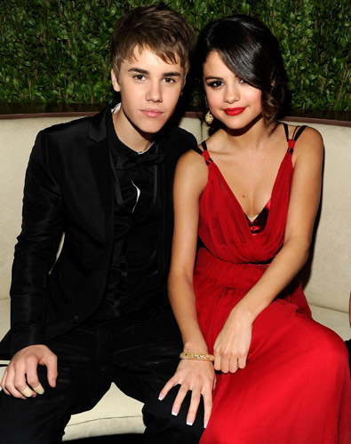
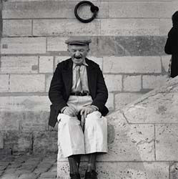
“hand on knee” vs. “hands on knees”
http://www.experienceproject.com/stories/Love-Old-People/132483
http://www.2dayfm.com.au/entertainment/the_dirt/blog/video-bieber-gets-birthday-kisses-from-selena/20110301-bjwl.html
Methodologies Sketch Engine Collocates Self vs Other Conclusions

Slide 27
FINGER constructions
 | SELF/OTHER
finger(s) in ear(s) | SELF | 25/25
PUT finger(s) to lip(s) | SELF | 40/44
fingers into hair | OTHER | 11/11
fingers in hair | OTHER | 15/15
fingers through hair | SELF | 47/72
fingers through hair | OTHER | 25/72
Methodologies Sketch Engine Collocates Self vs Other Conclusions

Slide 28
ARM constructions
 | SELF/OTHER
arms across chest | SELF | 30/30
arms above head | SELF | 33/33
male arm(s) around female waist | OTHER | 37/38
female arm(s) around male waist | OTHER | 2/38
female arms around male neck | OTHER | 38/39
male arms around female neck | OTHER | 1/39
Methodologies Sketch Engine Collocates Self vs Other Conclusions

Slide 29
ARM constructions
 | SELF/OTHER
arms across chest | SELF | 30/30
arms above head | SELF | 33/33
male arm(s) around female waist | OTHER | 37/38
female arm(s) around male waist | OTHER | 2/38
female arms around male neck | OTHER | 38/39
male arms around female neck | OTHER | 1/39
Methodologies Sketch Engine Collocates Self vs Other Conclusions

Slide 30
Attested Semantic Shifts of Body Parts
Part-whole | Structural similarity
nail - finger
finger - hand | finger - toe
palm - hand
hand - arm | hand - foot
forearm - arm
upperarm - arm
arm - shoulder | arm - leg
Methodologies Sketch Engine Collocates Self vs Other Conclusions

Slide 31
Unattested Semantic Shifts of Body Parts (?)
Associations within a single body | Associations between two bodies
arm – head (cf. arms above head) | arm – waist (cf. his arm around her waist)
arm – chest (cf. arms across chest) | arm – neck (cf. her arms around his neck)
hand – hair (cf. hand through hair) | hand – hair (cf. hand in hair)
hand – hip (cf. hands on hips) | hand – knee (cf. hand on knee)
hand – knee (cf. hands on knees)
finger – ear (cf. finger in ear) | finger – hair (cf. fingers in(to) hair)
finger – lip (cf. finger on lips)
Methodologies Sketch Engine Collocates Self vs Other Conclusions

Slide 32
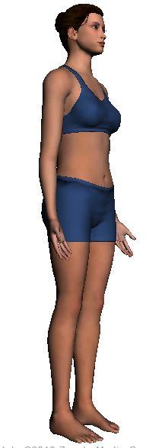
The Body Image
http://bodybrowser.googlelabs.com/
Methodologies Sketch Engine Collocates Self vs Other Conclusions

Slide 33
Conclusions for Language and Culture
Co-occurrence properties of body part terms, as used in a corpus, point to different biases in how we talk about body part terms.
The different constructional biases reveal recurring cultural images of our bodies and how they interact.
The images relate to both the Self and the interaction between Self and Others.
The image of the Self’s body is a dominant image.
Methodologies Sketch Engine Collocates Self vs Other Conclusions

Slide 34
Conclusions for Linguistic Analysis
Collocates, without regard for constructional properties, reveal very little about recurring images of bodily action. We need to work with collexemes, not just collocates.
Different word forms (sg. vs pl.) can reveal quite distinctive images of bodily action. We need to recognize the value of inflected forms, not just lemmas.
Gender differences can be found with body parts which might seem “ungendered”, e.g., arm.
Methodologies Sketch Engine Collocates Self vs Other Conclusions

Slide 35
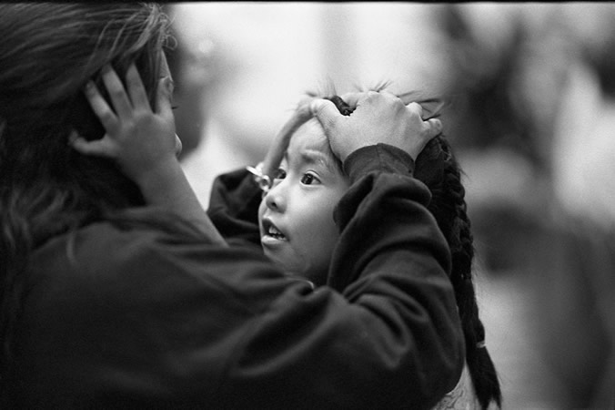
Thank you!
Used with permission of Steven Falconer. http://stevenfalconer.com/photos.php?gallery=hope

