Slide 1
The topic marker zi (是) in contemporary Shanghainese dialect
John Newman
Department of Linguistics, University of Alberta
&
Weifeng Han
Donghua University (Shanghai)
American Association of Corpus Linguistics Conference, San Diego State University
January 20 2013

Slide 2
Shanghainese dialect
Corpus-based analysis
Motivating zi as a topic-marker

Slide 3
Shanghainese dialect
Corpus-based analysis
Motivating zi as a topic-marker

Slide 4
shanghainese
Shanghainese is a dialect of Northern Wu Chinese spoken in the city of Shanghai and surrounding regions.
the written record can be traced back to the Northern Song Dynasty (960-1127 A.D.)
once served as the regional lingua franca of the entire Yangtze River Delta region
contains elements drawn from the different parts of the Northern Wu area (southern Jiangsu, northern Zhejiang).
Notes:
The language under study in this paper is Shanghainese (上海闲话 [zɑ̃²³hɛ³⁴ ɦɛ²³ɦo²³] in Shanghainese pronunciation), a dialect of Northern Wu Chinese spoken in the city of Shanghai and surrounding regions. We defer to the common tradition of referring to Shanghainese as a “dialect”, though one needs to be aware that Chinese dialects are more akin to what linguists would call distinct, but genetically related, languages. Shanghainese once served as the regional lingua franca of the entire Yangtze River Delta region and contains elements drawn from the different parts of the Northern Wu area (southern Jiangsu, northern Zhejiang). There are no official statistics available for the number of native speakers of Shanghainese (as opposed to the number of residents of the city or the greater Shanghai region). The Encyclopedia of Shanghai (2010: 403) reported 18.8846 million residents in the greater Shanghai area by the end of 2008, a number which includes permanent residents (who might be expected to be speakers) and those who have taken up residence more recently (who are most likely not speakers). We estimate the number of Shanghainese speakers in the region to be between 13 and 14 million.
“As to Shanghainese, we need to recognize there are two “Shanghai Dialects”, since in the historical development there formed two “Shanghainese”. One is what we call as “Old Shanghainese” started from the “Shanghai” community in the Southern Song Dynasty from more than seven hundred years ago (1127-1279), and is still used in the outskirts and suburbs of the nowadays Shanghai; the other is the so-called “New Shanghainese” which was adapted fast developed after the opening of Shanghai (1860) in downtown areas. (Qian 2007: 2)
From:
钱乃荣，2007，《上海方言》，上海：文汇出版社。 ?
Qian, Nairong. 2007. s?h?àn?g?h?ăi?f?ān?g?y?án? ?(?S?h?a?n?g?h?a?i? ?D?i?a?l?e?c?t?)?. Shanghai: Wenhui Books.

Slide 5
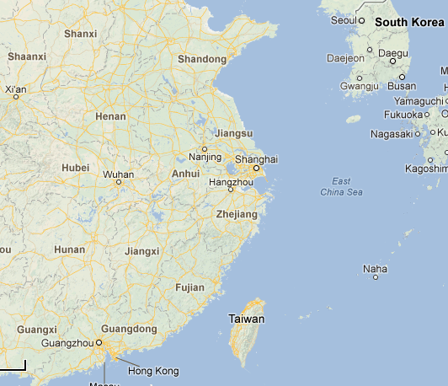
shanghai

Slide 6
shanghainese
We estimate the number of Shanghainese speakers in the region to be between 13 and 14 million.
A [Shanghai dialect project]: “Some 50 people, 25 around the age of 30 and the remainder in their 50s, are wanted to contribute their voices. Since recruitment has ground to a halt, Qian told Shanghai Daily yesterday that they are considering other methods to locate candidates.”
The Shanghai Dialect Club
Shanghainese Spoken Corpus (Jiali Mao and John Newman) http://www.johnnewm.org/
Notes:
english.eastday.com, 18 Dec 2010
http://www.zoominfo.com/#!search/profile/person?personId=835391764&targetid=profile [cached]

Slide 7
Shanghainese dialect
Corpus-based analysis
Motivating zi as a topic-marker

Slide 8
The corpus
Monologue. Individual speakers invited to talk in Shanghainese (47,663 words)
Interview. Interviews conducted by Weifeng Han and Jiali Mao with some prepared general questions (31,251 words)
Script. Based on movies and cartoons which have been dubbed into Shanghainese. (20,942 words)
Conversation. Conversations between local Shanghainese speakers in downtown Shanghai (28,709 words)
Total of 128,565 word tokens

Slide 9
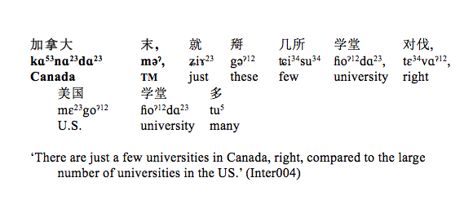
topic-comment
Han, Weifeng. (2010). A typological study of the syntactic properties of Topic and Topic Markers. PhD Dissertation, Shanghai International Studies University.

Slide 10
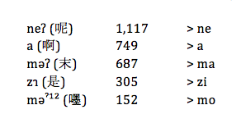
5 topic markers
Notes:
five most frequently used topic markers in our corpus, as determined by total occurrence of tokens. These turned out to be ne^{ʔ} (呢) with a frequency of 1,117, a (啊) 749, mə^{ʔ} (末) 687, zɿ (是) 305, and məˀ¹² (嚜) 152. Some brief background comments on each of these topic markers are in order (cf. Chu 1987: 218 for the early history of these forms). mə^{ʔ} and məˀ¹² are specifically Shanghainese topic markers, whereas the remaining three have some currency outside of Shanghainese and have more presence in the history of Chinese. The topic marker a (啊) would appear to be the topic marker with the most general currency, being used in many Chinese dialects and Mandarin (and hence, feels most “formal” when used in Shanghainese, according to our Shanghainese-speaking co-author, WH). zɿ is the youngest of the five, having evolved during the Ming Dynasty from earlier uses as a copula and as a focus marker. In addition to being specific to Shanghainese, mə^{ʔ} and məˀ¹² are also used only as topic markers in Shanghainese (as mentioned in the preceding paragraph).

Slide 11
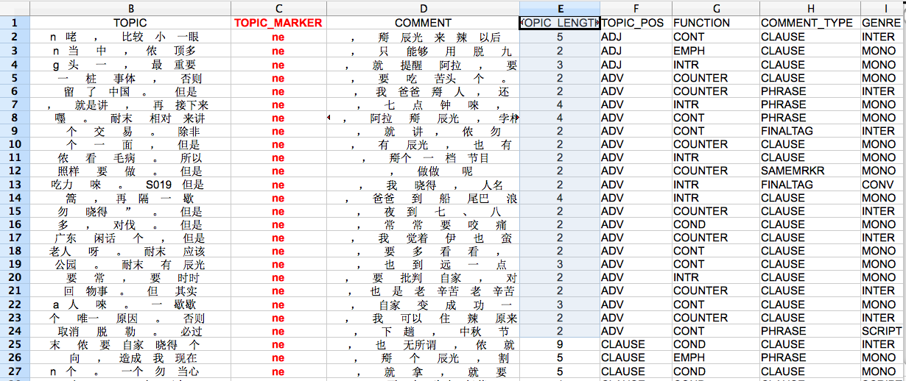
data in spreadsheet

Slide 12
Factors of interest
Factor | Levels
Syntactic category of the topic | NOMINAL (NOM) VERBAL (VERB) ADJECTIVAL (ADJ) ADVERBIAL (ADV) CLAUSAL (CLAUSE)
Main function of the topic-comment structure | INTRODUCTORY (INTR) EMPHATIC (EMPH) CONTRASTIVE (CONT) CONDITIONAL (COND) COUNTEREXPECTED (COUNTER)

Slide 13
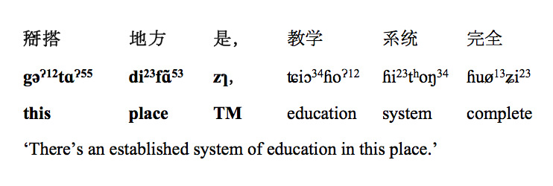
coding example 1
TOPIC_POS: NOMINAL
FUNCTION: INTRODUCTORY

Slide 14
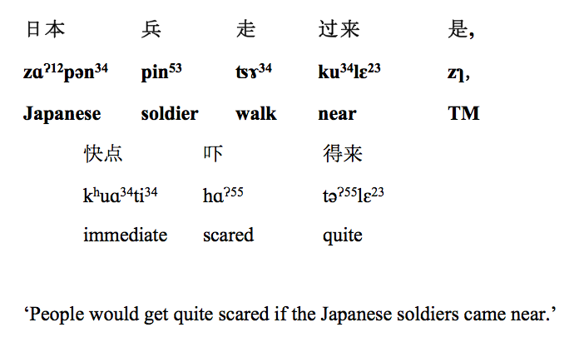
coding example 2
TOPIC_POS: CLAUSAL
FUNCTION: CONDITIONAL

Slide 15
coding example 3
TOPIC_POS: NOMINAL
FUNCTION: CONTRASTIVE

Slide 16
shanghainese dataframe

Slide 17
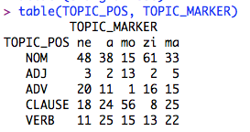
pos x topic marker observed

Slide 18
pos x topic marker residuals

Slide 19
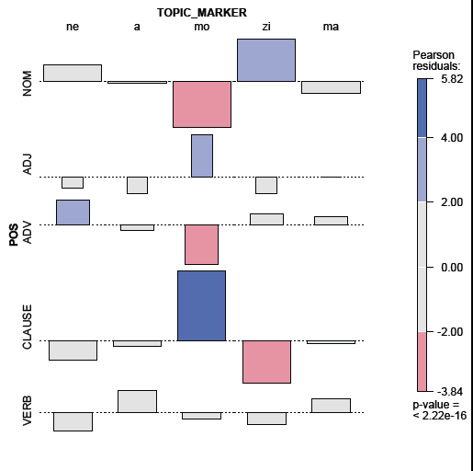
TM x POS association plot
significant preference for NOM with zi

Slide 20
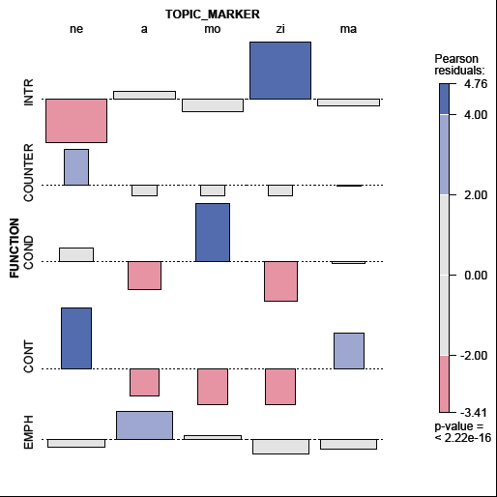
TM x function association plot
significant preference for INTR with zi

Slide 21
HCFA results TM x POS x function
significant preference for NOM + INTR for zi
significant preference for ADV + INTR for zi
Gries, Stefan Th. (2004). HCFA 3.2. A program for R. URL: <http://www.linguistics.ucsb.edu/faculty/stgries/

Slide 22
findings of the corpus-based analysis
Chi-square residuals (=association plots) ->
NOMINAL pos for topic
INTRODUCTORY function
Hierarchical Configural Frequency analysis ->
NOMINAL pos + INTRODUCTORY function (stronger)
ADVERBIAL pos + INTRODUCTORY function (weaker)

Slide 23
Shanghainese dialect
Corpus-based analysis
Motivating zi as a topic-marker

Slide 24
zi (是) in history
Ming Dynasty (1368-1644 A.D) uses of 是
adjective
pronoun
demonstrative
copula
focus marker
affirmative particle
topic marker (emergent)
Notes:
Therefore, ‘shi’ was originally used as an adjective meaning ‘right’ or ‘correct’.
e.g.
偃 之 言 是 也。
iɛn⁵¹ tʂʅ⁵⁵ iɛn³⁵ ʂʅ⁵¹ iɛ²¹⁴.
yàn zhī yán shì yĕ.
Yan GEN words correct PRT
‘Yan’s words are correct.’
（论语·阳货, c.a. 5th B.C.）

Slide 25
zi (是) in history
Ming Dynasty (1368-1644 A.D) uses of 是
adjective
pronoun
demonstrative
copula
focus marker
affirmative particle
topic marker (emergent)

Slide 26
copula vs topic-comment
nominal subject copula predicate nominal
THEME (GIVEN) 是 RHEME (NEW)
(preferred) nominal topic TM comment

Slide 27
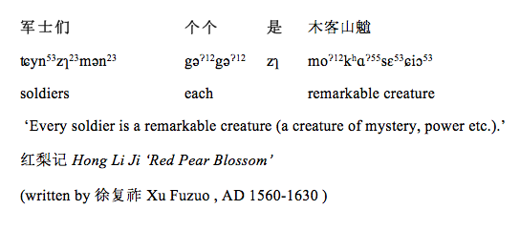
zi (是) the Red Pear blossom

Slide 28
pause options

Slide 29
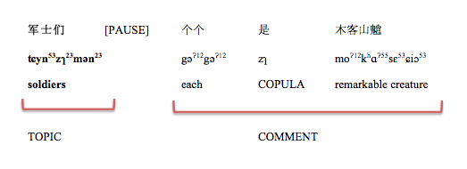
short topic – long comment

Slide 30
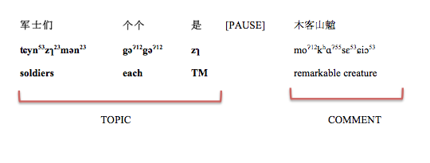
long topic – short comment

Slide 31
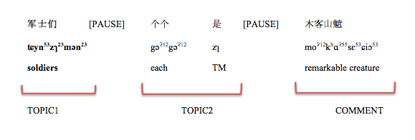
2 topics – 1 comment

Slide 32
origin(s) of TM 是
copula use in Shanghainese ca. 1500
contemporary Shanghainese topic marking use

Slide 33
origin(s) of TM 是
copula use in Shanghainese ca. 1500
continued copula use in Shanghainese post 1500
contemporary Shanghainese topic marking use

Slide 34
origin(s) of TM 是
copula use in Shanghainese ca. 1500
continued copula use in Shanghainese post 1500
copula use in contemporary Mandarin
contemporary Shanghainese topic marking use

Slide 35
The Shanghainese Corpus allows us investigate the use of zi 是 (and gives us a record of a dialect under threat)
Statistical analysis allows us to identify the most significant properties of zi 是 in contemporary use
The corpus-based analysis suggests the influence of the copula use of zi 是
THANK YOU

